Slide 1
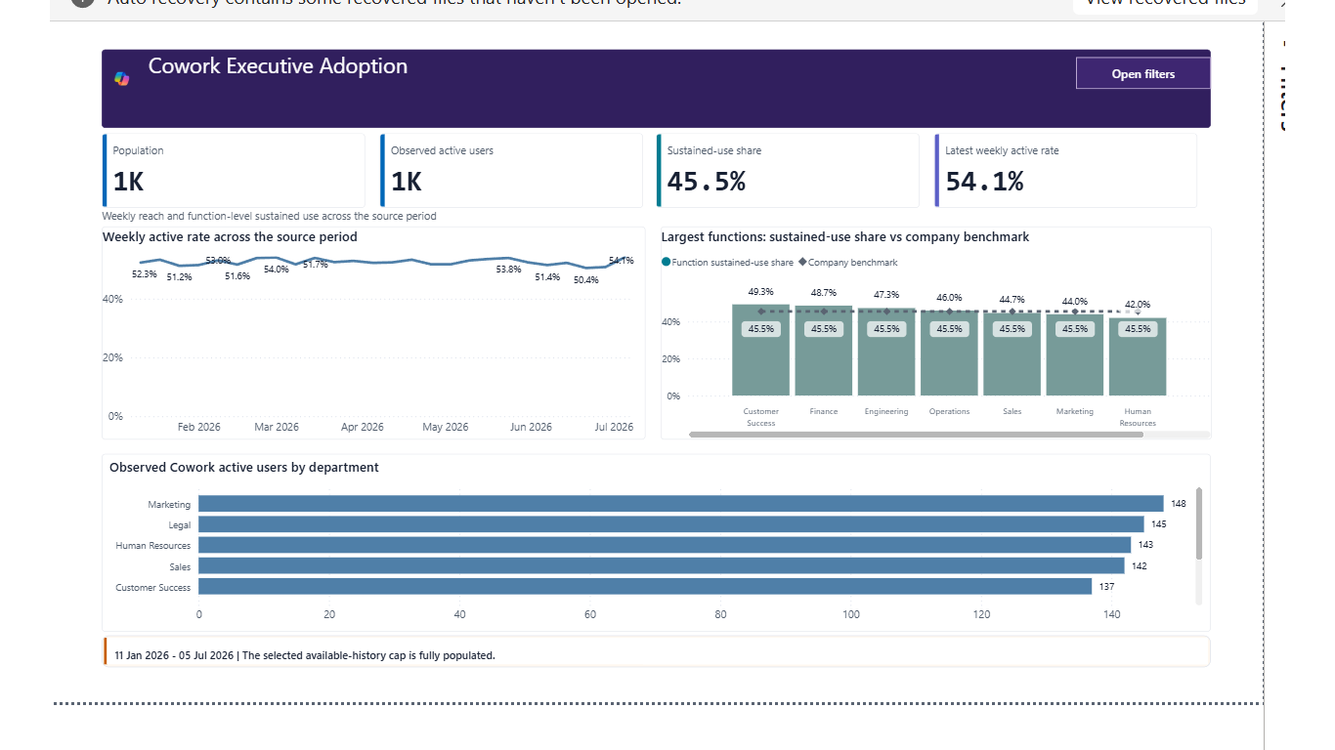
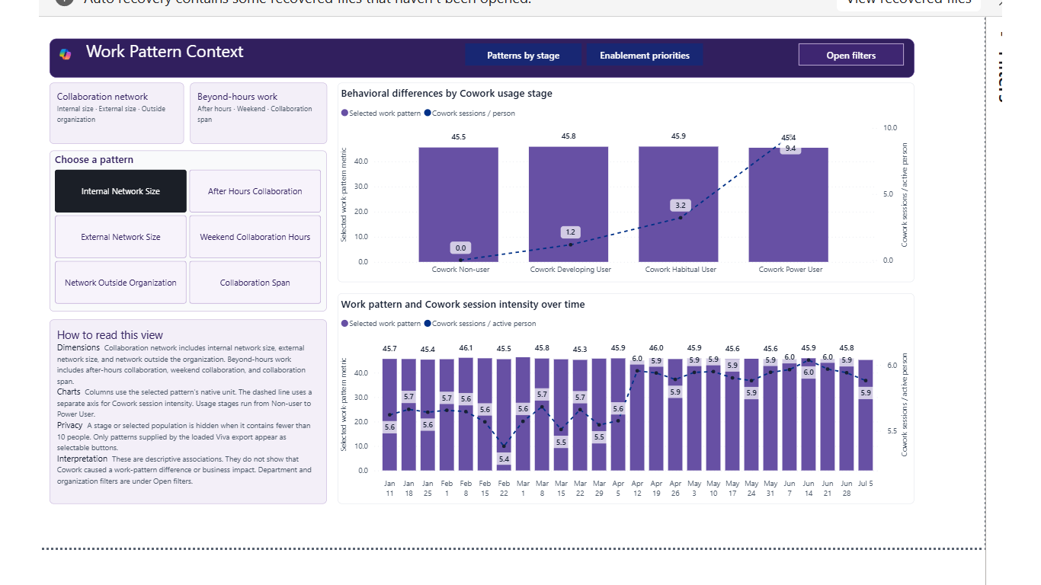
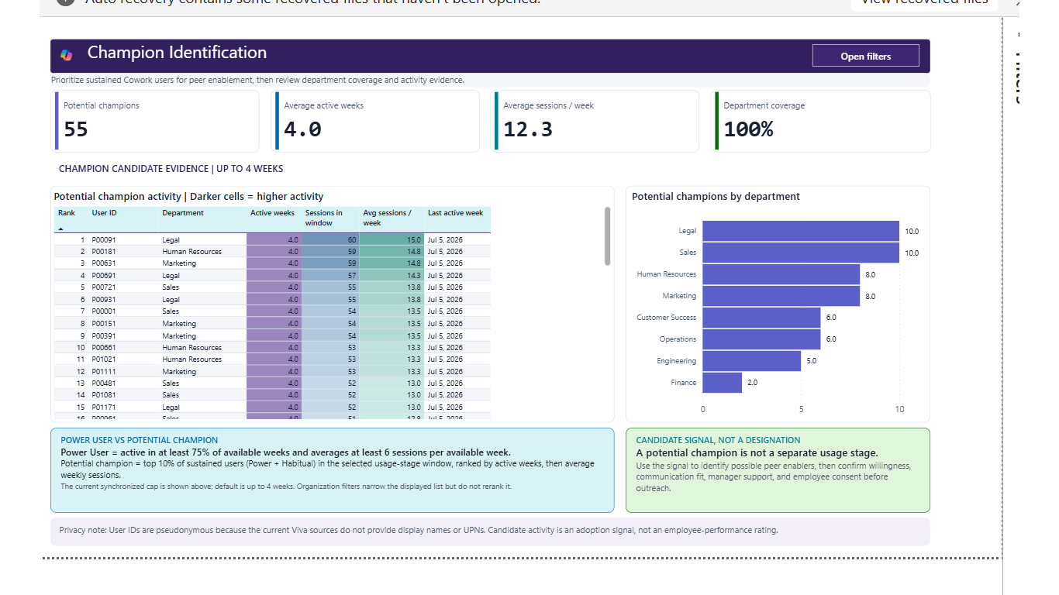
VERSION 1.0 | PUBLIC
CoworkSuperUser
Interpretation Storyboard
A practical operating guide for Cowork reach, return, usage stages, consumption, potential champions, work-pattern context, and defensible action.
Deterministic fabricated data | 1,200 fictional people | 26 weeks

Slide 2
Agenda
Orientation, page walkthroughs, methodology, query setup, and defensible language
1 Release orientation
2 Evidence model
Two connection choices and a five-minute reading path
Sources, grains, privacy, available-history logic, and wording
3 Page walkthrough
4 Methodology
All nine report pages in order
Stages, movement, champions, work-pattern context, and consumption
5 Query pipeline
6 Decision language
Person Query, Cowork consumption query, identifiers, and validation
Safe claims, boundaries, and presenter checklist
GUARDRAIL
Carry the exact period, population, filters, source status, evidence class, and privacy state with every quoted result.
microsoft/CoworkSuperUser
Version 1.0 | Public | Interpretation Guide
2

Slide 3
What's in version 1.0
A customer-ready Viva Insights release with two setup paths and one interpretation contract
Two published templates
Available-history stages
Current visual QA
Direct Query for script-free saved-query setup and Optimized Export for the fastest validated refresh.
Up to 4- and 12-week windows load early histories and clearly identify provisional results.
Nine pages, 39 bookmark states, 117 measures, and grid-aligned headers.
Employee drill paths
Public-safe assets
Reproducible release
Department-to-pseudonymous-User-ID expansion is available but collapsed by default.
PBIT files contain no customer data, tenant IDs, local QA paths, or cached model data.
Sanitized PBIP sources, validation tooling, interpretation guide, and narrated walkthrough.
GUARDRAIL
Both templates share the same report design and logic; only the source connection path differs.
microsoft/CoworkSuperUser
Version 1.0 | Public | Interpretation Guide
3

Slide 4
Five-minute orientation
If time is limited, read these four pages in order
1
2
3
4
Executive Adoption
Weekly Adoption & Usage
Habit Movement
Work Pattern Context
Establish observed reach, sustained use, and latest weekly activity.
Decide whether the latest result is sustained, returning, or concentrated.
See whether people moved to stronger stages or slipped.
Frame descriptive pattern differences and department enablement prompts.
Before sharing
Confirm the exact metric definition and evidence class on Methods and Metric Guide. Use Champion Identification only for enablement outreach and Adoption by Attributes only after population and field coverage are checked.
GUARDRAIL
One page answers the question; a second page supplies context. More pages do not automatically create a stronger conclusion.
microsoft/CoworkSuperUser
Version 1.0 | Public | Interpretation Guide
4

Slide 5
Evidence model at a glance
Two observed query results become one privacy-aware person-week model
Viva Insights Person Query
Decision pages
Person + week
Population spine, organization attributes, and work-pattern context.
Reach, return, movement, champions, consumption, attributes, and work patterns.
Integrated person-week model
Sunday-start weeks
Validated uniqueness
Cowork-only aggregation
Coverage-aware zeros
Available-history stages
Cowork consumption result
Interpretation controls
Person + service + policy + date
Sessions, credits, coverage, and policy context.
10-person privacy floor, definitions, evidence classes, and provisional history.
GUARDRAIL
A missing fact becomes zero only when that week is covered. Missing optional fields and uncovered periods remain unavailable.
microsoft/CoworkSuperUser
Version 1.0 | Public | Interpretation Guide
5

Slide 6
Different evidence requires different wording
Match the claim to the calculation's actual evidence condition
OBSERVED
DERIVED
CONTEXT
Direct source aggregation
"The connected result contains..."
Arithmetic over observed fields
"The report calculates..."
Descriptive non-causal comparison
"The selected groups differ descriptively..."
REFERENCE
UNAVAILABLE
Carry the context
Template definition or rule
"The template defines..."
Dependency, population, or history absent
"This cannot be calculated from the current inputs..."
Period | Population | Filters | Source status | Evidence class | Privacy state
GUARDRAIL
Numerically correct results can still be unsuitable when their denominator, time grain, privacy state, or evidence class is omitted.
microsoft/CoworkSuperUser
Version 1.0 | Public | Interpretation Guide
6

Slide 7
SECTION 1
Page-by-page walkthrough
Read every page in five layers: purpose, reading order, diagnostic questions, action, and guardrail.
Purpose | Read | Diagnose | Act | Guardrail
CoworkSuperUser | Version 1.0 | Public
7

Slide 8
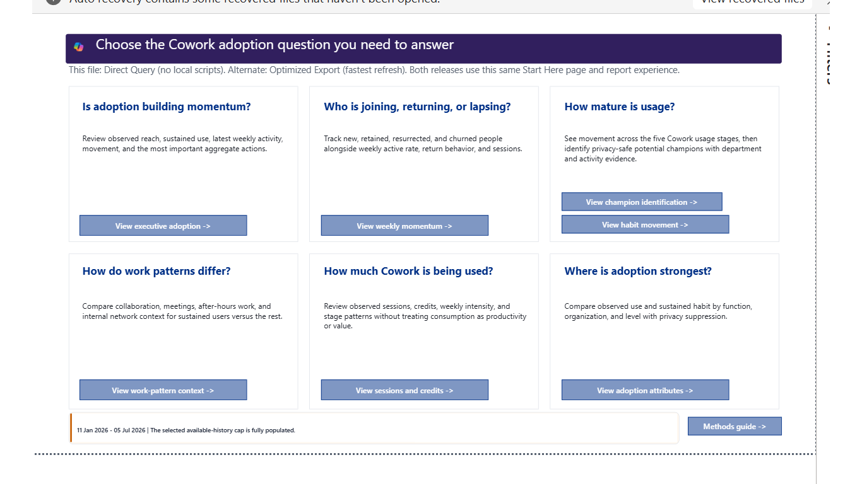
Start Here
Route each business question to the right evidence and boundary
1
Purpose
Choose momentum, cohorts, maturity, work patterns, consumption, or organizational comparison.
2
Select the decision
Open one primary page instead of treating every card as one scorecard.
3
Check the window
Confirm Up to 4 or Up to 12 weeks and the available-history message.
4
Use one corroborating page
Support the headline with trend, denominator, or source context.
5
Record context
1 of 9 report pages
Carry period, population, filters, evidence class, and privacy state forward.
GUARDRAIL
Start Here is a decision router, not an automatic narrative or composite score.
microsoft/CoworkSuperUser
Version 1.0 | Public | Page walkthrough
8

Slide 9
Executive Adoption
Observed reach, sustained use, latest weekly activity, and function distribution
1
Purpose
Summarize the current adoption state for the selected population.
2
Read population first
The analytical denominator comes from the coverage-qualified Person Query.
3
Separate reach and habit
Observed active users and sustained-use share answer different questions.
4
Read the latest week
Use latest weekly active rate with the trend - not in isolation.
5
Corroborate
2 of 9 report pages
Open Weekly Adoption & Usage and the function benchmark before acting.
GUARDRAIL
Observed user share is not an entitlement-based adoption rate without an approved Cowork eligibility roster.
microsoft/CoworkSuperUser
Version 1.0 | Public | Page walkthrough
9

Slide 10
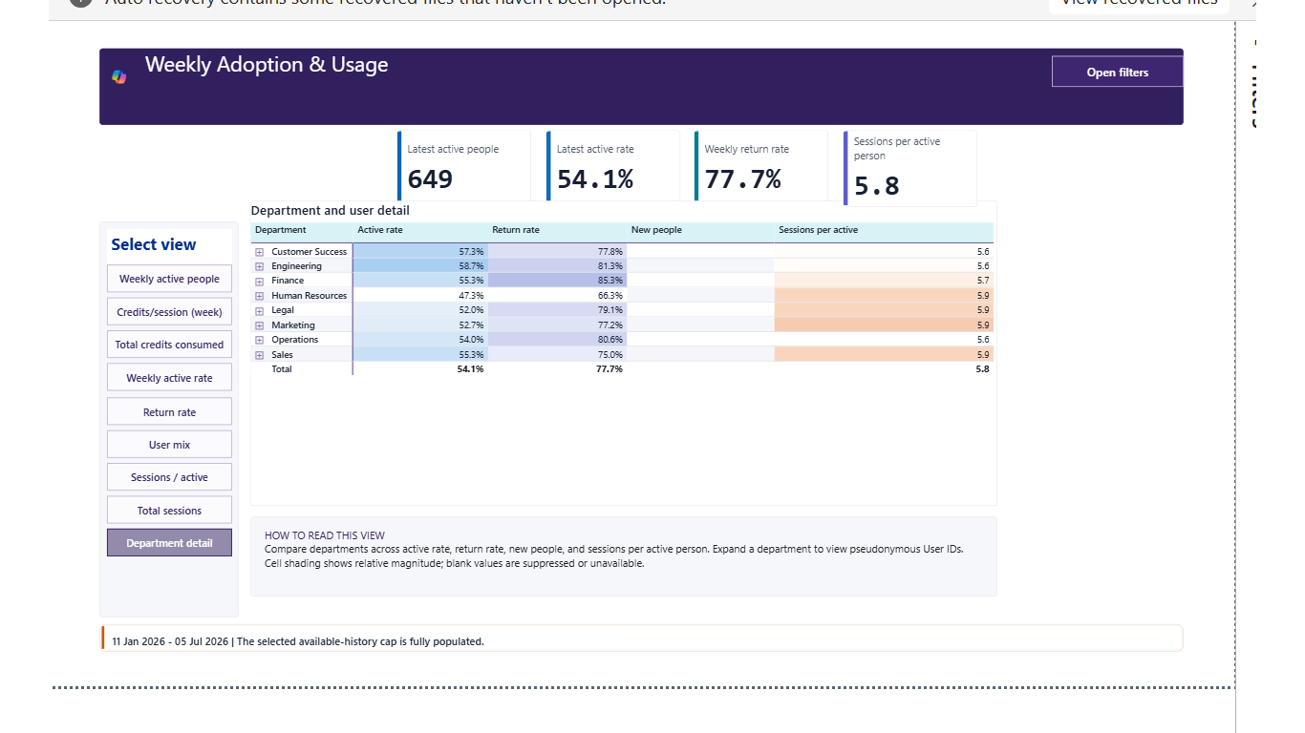
Weekly Adoption & Usage
Reach, return, cohorts, sessions, and credits over time
1
Purpose
Explain whether use is growing, recurring, and distributed.
2
Select one view
Bookmark controls preserve filters while changing the question.
3
Read exact values
Color is relative; table and heatmap numbers carry precision.
4
Diagnose the cohort
Separate new, retained, resurrected, and churned people.
5
Choose the response
3 of 9 report pages
Map reach, return, or intensity gaps to different enablement actions.
GUARDRAIL
Sessions and credits describe usage and consumption - not task completion, productivity, quality, or business value.
microsoft/CoworkSuperUser
Version 1.0 | Public | Page walkthrough
10

Slide 11
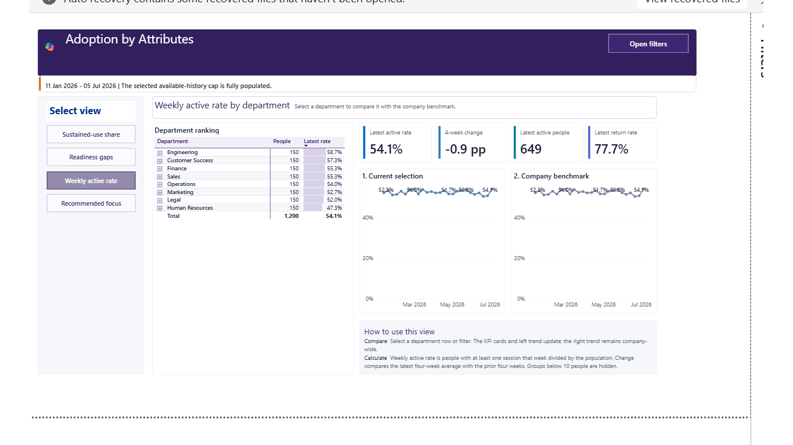
Adoption by Attributes
Compare observed reach and sustained use across organization attributes
1
Purpose
Locate organization groups with different adoption and habit patterns.
2
Check population
Confirm the comparison meets the 10-person privacy floor.
3
Choose a lens
Compare reach, sustained use, weekly activity, or recommended focus.
4
Read the benchmark
Company comparison removes only the selected Function filter.
5
Validate locally
4 of 9 report pages
Role mix, rollout timing, and work type can explain differences.
GUARDRAIL
Organizational differences are program signals, not employee-performance comparisons.
microsoft/CoworkSuperUser
Version 1.0 | Public | Page walkthrough
11

Slide 12
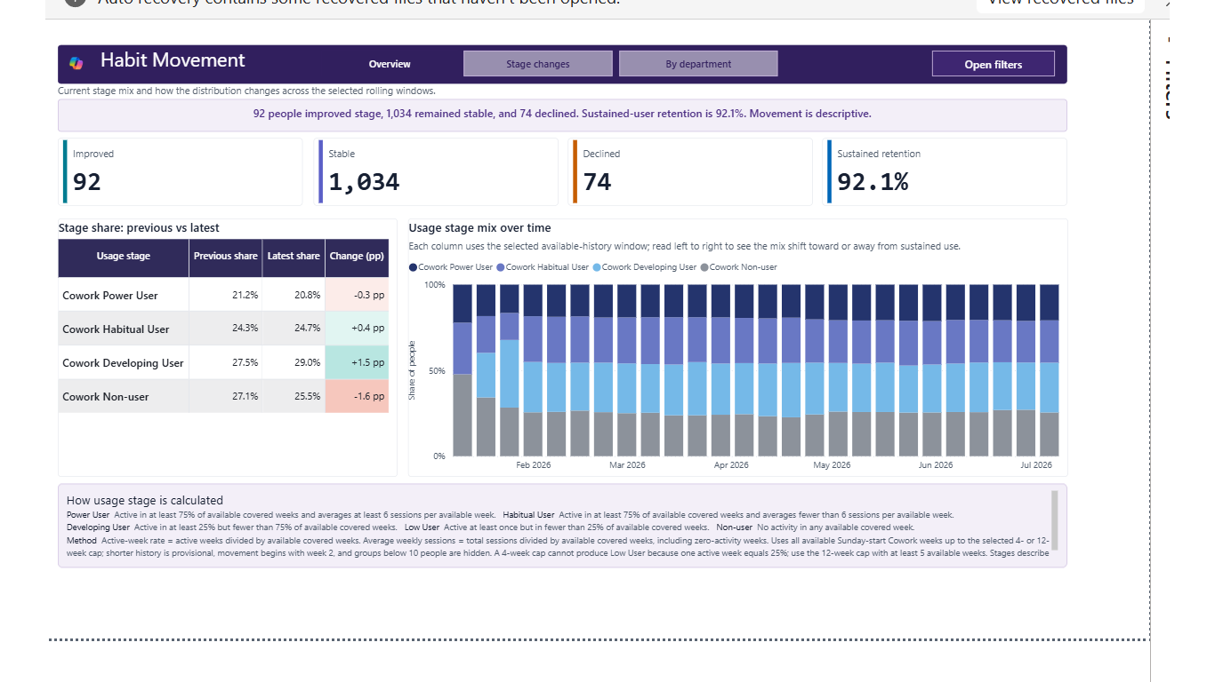
Habit Movement
Compare previous and latest adjacent usage-stage windows
1
Purpose
See whether people improved, remained stable, or declined.
2
Read the totals
Improved, stable, declined, and sustained retention establish the movement.
3
Read stage shares
A positive change is interpreted with the stage label.
4
Check the trend
The stack shows how the mix changes across available weeks.
5
Open department view
5 of 9 report pages
Locate where movement differs before selecting an intervention.
GUARDRAIL
Movement is descriptive and can reflect new history, organizational changes, or temporary behavior.
microsoft/CoworkSuperUser
Version 1.0 | Public | Page walkthrough
12

Slide 13
Champion Identification
Potential peer-enablement partners and department coverage
1
Purpose
Find a small, transparent outreach starting point.
2
Check the window
Candidate evidence is provisional before the selected cap is populated.
3
Read consistency
Active weeks appear before session intensity in the global ranking.
4
Check coverage
Department coverage reveals enablement gaps.
5
Validate people
6 of 9 report pages
Confirm role fit, willingness, manager support, and appropriate data use.
GUARDRAIL
Potential champion status is not expertise, aptitude, performance, promotion, or compensation evidence.
microsoft/CoworkSuperUser
Version 1.0 | Public | Page walkthrough
13

Slide 14
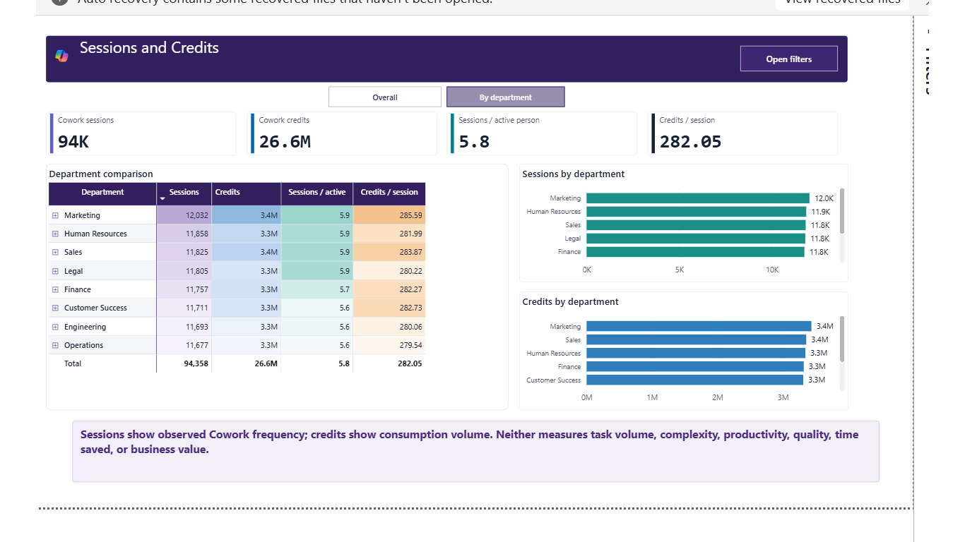
Sessions and Credits
Observed Cowork frequency and resource consumption
1
Purpose
Describe usage volume without converting it into value.
2
Read totals
Sessions and credits answer separate consumption questions.
3
Read intensity
Sessions per active person and credits per session are descriptive ratios.
4
Switch the view
Overall and By department use the same filter context.
5
Drill carefully
7 of 9 report pages
User IDs are available under departments but remain collapsed by default.
GUARDRAIL
Sessions are not tasks. Credits are not productivity, quality, complexity, time saved, or business value.
microsoft/CoworkSuperUser
Version 1.0 | Public | Page walkthrough
14

Slide 15
Work Pattern Context
Descriptive collaboration and network patterns by Cowork stage
1
Purpose
Frame local questions about collaboration network and beyond-hours work.
2
Select one pattern
Only metrics supplied by the Person Query are selectable.
3
Compare stages
The Non-user group is a descriptive reference, not a control group.
4
Read separate axes
Pattern averages and Cowork sessions use independent scales.
5
Open priorities
8 of 9 report pages
Department enablement prompts explain what to investigate next.
GUARDRAIL
Differences are descriptive and non-causal. Cowork use can coexist with a pattern without causing it.
microsoft/CoworkSuperUser
Version 1.0 | Public | Page walkthrough
15

Slide 16
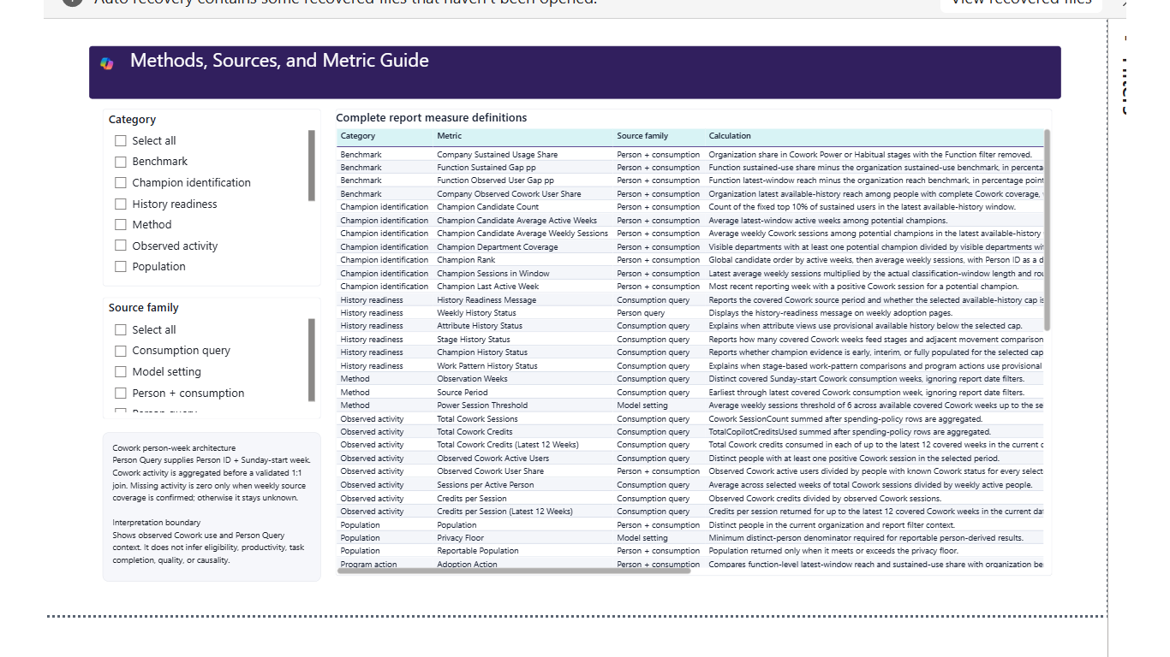
Methods and Metric Guide
Definitions, sources, calculations, grains, directions, and caveats
1
Purpose
Settle the definition before the metric enters a decision record.
2
Filter to the page
Find the exact metric name and source family.
3
Read the calculation
Confirm grain, denominator, and window behavior.
4
Read the caveat
Check privacy, optional fields, and evidence status.
5
Copy the context
9 of 9 report pages
Record the definition, filters, version, and source state.
GUARDRAIL
Missing evidence means unavailable, not zero; a correct measure can still be unsuitable without context.
microsoft/CoworkSuperUser
Version 1.0 | Public | Page walkthrough
16

Slide 17
Two connection options. One report experience.
Choose the implementation path without changing the visuals or interpretation
Direct Query template
Optimized Export template
Customer inputs
- Partition Identifier
- Person Query Identifier
- Consumption Query Identifier
Best for
- Script-free setup
- Connector-only deployment
- Scheduled Power BI refresh
Validated end-to-end load: about 1.9 minutes for the QA source.
Customer inputs
- Partition Identifier
- Person Query Identifier
- Cowork consumption export folder
Best for
- Fastest refresh
- Support fallback
- Controlled CSV handoff
Validated end-to-end load: about 1.1 minutes for the QA source.
Both files contain the same 9 pages | 39 bookmarks | 117 measures | Start Here experience
GUARDRAIL
The connector template imports saved-query results during refresh; it is not Tabular DirectQuery storage mode.
microsoft/CoworkSuperUser
Version 1.0 | Public | Operations
17

Slide 18
SECTION 2
Methodology and operating controls
Understand the windows, thresholds, populations, privacy rules, source checks, and deployment sequence behind the visuals.
Purpose | Read | Diagnose | Act | Guardrail
CoworkSuperUser | Version 1.0 | Public
18

Slide 19
Methodology | Available-history usage stages
Stages use covered Cowork weeks up to the selected 4- or 12-week cap
Power User
Habitual User
Developing User
Low-user
Non-user
At least 75% active weeks
and at least 6 average sessions/week
At least 75% active weeks
below the Power threshold
25%-74% active weeks
<25% active weeks
but at least one session
No positive Cowork session
Up to 4 weeks
Up to 12 weeks
Adjacent movement
Default. Loads from the first covered week and becomes fully populated at four weeks.
Longer habit lens. Results remain provisional until twelve covered weeks are available.
Previous and latest windows use the available history and require at least two covered weeks.
GUARDRAIL
Stage labels describe observed Cowork usage under template rules. They are not capability, value, quality, or performance ratings.
microsoft/CoworkSuperUser
Version 1.0 | Public | Methodology
19

Slide 20
Methodology | Habit movement
Compare adjacent windows without treating every movement as inherently good or bad
Improved
Stable
Latest stage ranks above the previous stage.
Latest and previous stages match.
Declined
Sustained retention
Latest stage ranks below the previous stage.
Previously sustained users who remain Power or Habitual.
Interpret the direction with the starting and ending stage
GUARDRAIL
Counts and transitions below the 10-person privacy floor are suppressed; source changes can move classifications.
microsoft/CoworkSuperUser
Version 1.0 | Public | Methodology
20

Slide 21
Methodology | Potential champions
A transparent filter-sensitive ranking that always ends with human validation
1
2
3
4
SUSTAINED
RANK
SELECT
VALIDATE
Power or Habitual in the latest window
Active weeks, then average weekly sessions
Fixed top 10% with deterministic tie-breaking
Role fit, willingness, manager support, data use
Stability checks
Organization filters narrow the displayed list but do not rerank global candidates. Department coverage excludes missing department names. Before four covered weeks, the report labels the evidence provisional.
GUARDRAIL
The candidate list is an outreach starting point - never an automatic action or a personnel decision.
microsoft/CoworkSuperUser
Version 1.0 | Public | Methodology
21

Slide 22
Methodology | Work-pattern context
Use one selected pattern and one explicit non-causal question
Collaboration network
Beyond-hours work
Internal network size
External network size
Network outside organization
Question: do stages differ descriptively in the size or mix of reciprocal connections?
After-hours collaboration
Weekend collaboration
Collaboration span
Question: do stages differ descriptively in when collaboration occurs?
Stage comparison
Weekly trend
Selected stage average minus the Non-user average, divided by the Non-user average. Both groups must meet the privacy floor.
The selected pattern and Cowork session intensity use separate axes. Compare direction and timing - not absolute magnitudes.
GUARDRAIL
No work-pattern measure establishes Cowork impact. Treat every difference as a prompt for local investigation.
microsoft/CoworkSuperUser
Version 1.0 | Public | Methodology
22

Slide 23
Data pipeline | Build, connect, validate
One shared partition, two completed analyses, and a repeatable refresh gate
1
2
3
4
5
Person Query
Consumption query
Wait for Success
Connect
Validate
Week grouping, active population, organization attributes, and complete work-pattern metrics.
Day grouping, Service Name = Cowork, sessions, credits, and policy limits.
Never connect or export a result that is still processing.
Enter raw GUIDs in Direct Query or export Cowork CSV for Optimized Export.
Population, weeks, sessions, organization coverage, work patterns, privacy, and no errors.
Recommended query period
Use a rolling six-month Person Query when possible. Shorter histories load, but longer history produces stronger 12-week stage and movement context.
GUARDRAIL
Both analyses must use the same partition and overlapping dates. Do not remove required columns after export.
microsoft/CoworkSuperUser
Version 1.0 | Public | Operations
23

Slide 24
Defensible decision language
End with the evidence, the boundary, and an owned next step
Reach broadening
"Observed Cowork reach increased in the selected population and period."
Sustained use
"The report calculates a larger Power or Habitual share under the selected window rules."
Department difference
"The displayed group differs from the company benchmark; role and rollout context should be checked."
Champion outreach
"These users meet the sustained-use evidence rule; role fit and willingness still require confirmation."
Consumption change
"Observed sessions or credits changed; this describes usage, not value or productivity."
Work-pattern difference
"The stages differ descriptively on this pattern; no causal claim is supported."
Do not claim causality, realized savings, employee performance, or a cross-tenant benchmark.
microsoft/CoworkSuperUser
Version 1.0 | Public | Interpretation Guide
24

